Slide 1

Java Packages

Slide 2
Contents
TBDDDD

Slide 3
Packages
A package is a bundle of classes or interfaces. The purpose of package is
Avoids name collision between classes or interfaces having same name. Eg. It is possible to have a class Abc in p1 package, and another Abc class in p2 package
Improves modularity of the code
Class members with default or none access specifier, can be accessed only within the package.
Promotes distributed development.
A package, can further have sub packages.

Slide 4
Packages
Below are keywords used in packages
package – indicates that the current file belongs to certain package. Each file can have only one package statement, that too it need to be first statement in a .java file
import - code in the file is dependent on class or interface in some other package. Each .java file can have any number of import statements.
A separate folder or directory is created for each package. A package can be spread across multiple .java files. When IDEs are used folder is automatically created, when a new package is created.

Slide 5
When code is developed with Notepad and command prompt, folder need to be manually created, with same name as package name.

Slide 6
Packages
package com.p1
package com.p2
Public Class A
(A.java)
Public Class A
(A.java)
Public Class D
(D.java)
import com.p1.B;
Public Class B
(B.java)
import com.p2.*;
Class E

Slide 7
Packages…
In a .java file, there can be only one public class, and the name of .java file must be same as public class name.
In a .java file, there can be any number of non public classes.
import p2.*; //it just imports direct classes in p2 package, but not sub packages of p2
import p2.sp1.*;
Generally a package can be named as below
com.company_name.project_name.module_name

Slide 8
For a class member to be accessible outside the package, both class member and the class also need to be public
Generally package name takes below format

Slide 9
Built in Packages in Java…
Below are built in Packages in Java
java.lang – this package is automatically imported by all java files. For eg. String, System classes are in java.lang package.
iava.util - Collections
java.io – Input and Output Programming
java.sql – connecting to database
java.time - date and time related classes/interfaces after java 8
java.net – networking or socket programming. It is used to create connection between two or more remote machines. Used to develop Applications like chat, file upload, etc…

Slide 10
Sub Packages…
A package may further have sub packages. And a sub package can further have sub packages
Same package and import keywords are used incase of declaring or using sub packages.

Slide 11
static import
Static members can be directly imported using static import statement, when the package or class name need not be mentioned repeatedly.
import static java.lang.System.*;
Also, without importing a specific package you can directly specify package and sub package directly in statements rather than importing. For example
p1.sp1.A obj = new p1.sp1.A();

Slide 12
Interface
An interface is a collection of method declarations , and without method definitions(i..e with out method body)
An interface is a pure abstract class
An interface can have declarations of constants. By default Constants in interface are static and final.
For eg.
interface Circle{
double PI=3.14;
double getSurfaceArea(double radius);
double getCircum(double radius);
}

Slide 13
Below are the keywords used in interfaces
interface – to declare an interface
implements – used with class which provides body for interface methods
An interface cannot be instantiated, but a reference can be declared of an interface.
Private, protected members are not allowed in interface. An interface cannot have constructor(s).
Each interface can have multiple implementations. And an interface reference can refer to any object(whose class implements the interface). Hence by using interface, it is possible to switch between multiple implementations, during run time. This is called run time polymorphism.

Slide 14
Reference
class A{
//statments
}
A obj;
obj = new A();
Reference

Slide 15
Interface
An interface can extend from one or more other interfaces, using extends keyword. Hence multiple inheritance is supported in interfaces.
Constructors or static methods not allowed in interface
An outer interface can be public or default. Public interface can be used in current and other packages as well.

Slide 16
By default interface and methods declared in interface are abstract, of course they can be explicitly declared as abstract.
A single class can implement from multiple interfaces.
Interfaces play vital role, in developing loosely coupled classes.

Slide 17
Basic advantages of Interface
Since java does not have header file, an interface can act like a header. So when you want to provide APIs(Application Program Interface) to your clients(who may further use your classes, etc.. in their Application) without source code, you can provide them an interface, instead of actual class.
Also, when there are multiple implementations for an interface, it is possible to dynamically switch between each implementation, in the run time.

Slide 18
Wrapper class
Primitive or built in types like int, float, etc… have corresponding Wrapper classes, which wrap the built in type, along with providing additional functionality.
These wrapper classes are in java.lang package.
Below are the wrapper classes

Slide 19
Wrapper class
Integer – int
Short - short
Byte - byte
Long - long
Float - float
Double - double
Boolean - boolean
Void - void
Note that all above Wrapper classes are final and cannot be inherited.

Slide 20
Wrapper class
All Wrapper class also provides max and min value, such as below
Integer.MAX_VALUE
Integer.MIN_VALUE

Slide 21
Inner class
A class can be defined as a member of another class, or within a method as well.
A Inner class within an Outer class, creates a special relationship between them, in which Inner class, can even access private members of Outer class.
But methods of Outer class cannot directly access members of Inner class.

Slide 22
An Inner class can be declared private, public, protected or static.
But Outer class can be either public or default only.
Inner Interface
It is possible to have an interface as a member of another class or interface.

Slide 23
Tools available in JDK
javac – to compile a .java file, which produces .class file
javadoc – to generate documentation. Generates HTML documentation files, for the classes and methods available in Application.
java - to run .class file
jar - to create jar file from set of .class files
How to decompile a .class file, is it possible to encrypt the .class file?

Slide 24
Environment Variables
What is CLASSPATH environment variable?
CLASSPATH environment variable need to be set with the paths, in which required .class files are available. There can be multiple paths, separated by ;
Java command searches for .class files in the paths set to CLASSPATH
Java – version to find java version installed on your system.
Can multiple Java versions be installed on a single machine, simultaneously?
JAVA_HOME environment variable points to the directory where the Java runtime environment (JRE) is installed on your computer.

Slide 25
Environment variables
Set the PATH environment variable if you want to be able to conveniently run the executables (javac.exe, java.exe, javadoc.exe, and so on) from any directory without having to type the full path of the command.
If PATH variable is not set, you need to specify the full path to the executable every time you run it, such as:
C:\Java\jdk1.7.0\bin\javac MyClass.java

Slide 26
The PATH environment variable is a series of directories separated by semicolons (;).
Microsoft Windows looks for programs in the PATH directories in order, from left to right.
You should have only one bin directory for the JDK in the path at a time (those following the first are ignored), so if one is already present, you can update that particular entry.

Slide 27
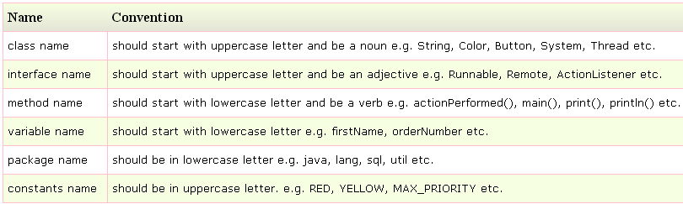
Naming Convention
Java naming convention is a rule to follow , for identifiers such as class, package, variable, constant, method etc.
But, it is not forced to follow. So, it is known as convention not rule.

Slide 28
Java follows camelcase syntax for naming the class, interface, method and variable.

Slide 29
Java.lang.Math
Below are the methods available in Math class
sin, cos, tan, exp, log, pow, sqrt
Java.lang.String

Slide 30
String Constant pool When we use double quotes to create a String, it first looks for String with same value in the String pool, if found it just returns the reference else it creates a new String in the pool and then returns the reference.
However using new operator, we force String class to create a new String object in heap space.
String Constant Pool is an example for Fly Weight Design Pattern.

Slide 31
javadoc command
Javadoc command is used to generate html documentation files.
Documentation comment is /** documentation here */

Slide 32
Eg.
/**
* The HelloWorld program implements an application that
* simply displays "Hello World!" to the standard output.
*
* @author Test Author
* @version 1.0
* @since 05-05-2016
*/
public class abc{
public static void main(String[] a) {
System.out.println("Hello World");
}
}
__________________
javadoc abc.java

Slide 33
jps - Java Virtual Machine Process Status Tool
The jps tool lists the instrumented HotSpot Java Virtual Machines (JVMs) on the target system.
The tool is limited to reporting information on JVMs for which it has the access permissions.

Slide 34
What is debugging?
Debugging is the process of checking the workability of a program.
While debugging, it is possible to run statement by statement, put break points, pause/resume execution, view/change values of any variables, during program execution.
Hence debugging helps to remove problems in the software.

Slide 35
String, StringBuilder, StringBuffer Difference
Mutability Difference: Generally there are many string instances in our applications.
String objects are immutable and their values cannot be changed after they are created.
StringBuffer and StringBuilder are mutable.
String always creates a new object when you try to update the same.

Slide 36
String Constant Pool Difference: String uses a pool internally unlike StringBuffer and StringBuilder. Though compiler implicitly uses pool for a String, you can explicitly do it using String s3=s1.intern();
This is advantage of String.
Here Fly Weight Design Pattern is used

Slide 37
Difference between String and StringBuffer
String is immutable, but StringBuffer is mutable.
That means a String object once created, cannot be changed, when any changes done, a new String object gets created, and old object may continue to exist.
But StringBuffer object once created, can get changed.

Slide 38
String performance
Thread-Safety Difference: Difference between StringBuffer and StringBuilder is that StringBuffer is thread-safe.
When the application needs to be run only in a single thread then it is better to use StringBuilder.
StringBuilder is more efficient than StringBuffer

Slide 39
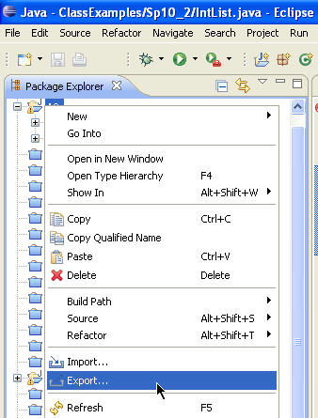
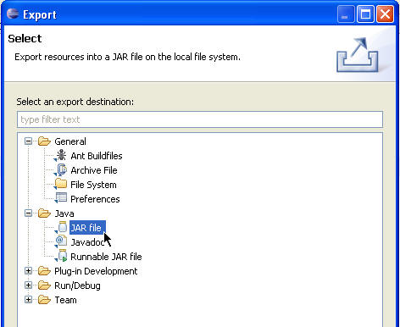
Create jar using Eclipse IDE
Either from the context menu or from the menu bar's File menu, select Export.
Expand the Java node and select JAR file. Click Next.

Slide 40
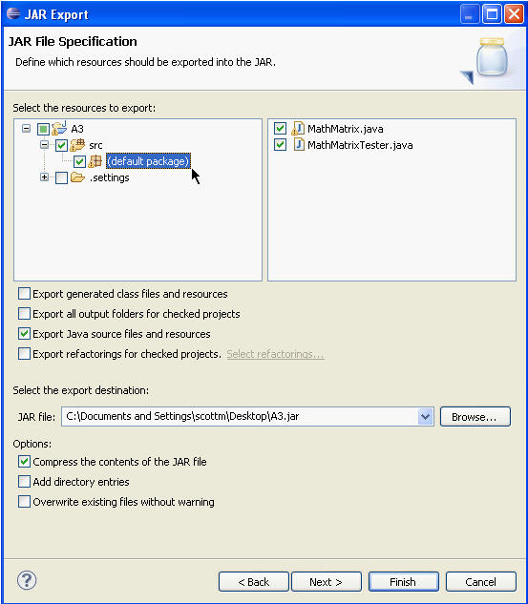
Create jar using Eclipse IDE
In the JAR File Specification page, select the resources that you want to export in the Select the resources to export field.

Slide 41
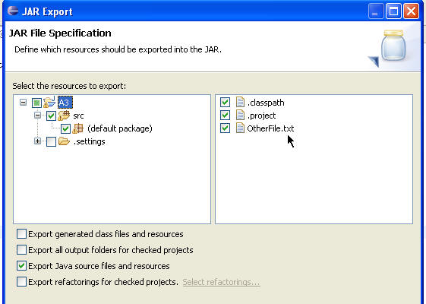
Select the appropriate checkbox to specify whether you want to Export generated class files and resources or Export Java source files and resources. If there are other files or resources you want to include they must be in a an open project. Browse to their location via the directory tree on the left and ensure the file or resource is checked in the window on the right.

Slide 42
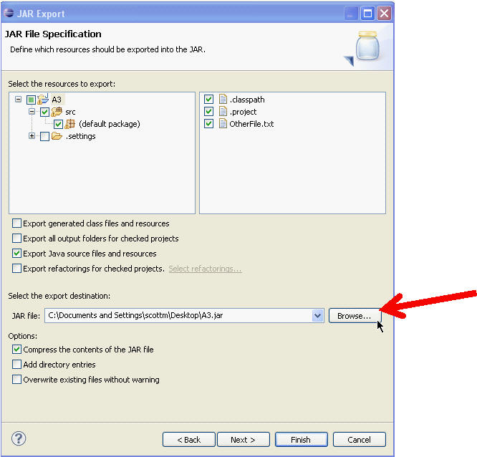
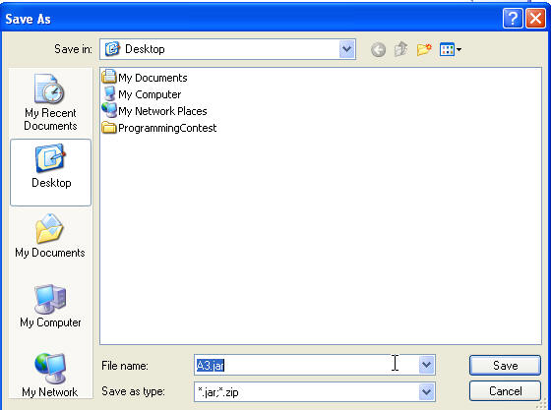
Create jar using Eclipse IDE
I
Select or clear the Compress the contents of the JAR file checkbox.
Click Finish to create the JAR file immediately.

Slide 43
Jar command
A JAR (Java Archive) is a package file format typically used to aggregate many Java class files and associated metadata and resources (text, images, etc.) into one file to distribute application software or libraries on the Java platform.

Slide 44
Creation of JAR File?
C:\> jar cf pack.jar pack
cf represents create the file. For example, assuming our package pack is available in C:\directory
Now , pack.jar file is created
Viewing a JAR file:
To view contents of .jar files, we can use the command as:
jar tf jarfilename

Slide 45
Jar command
How to extract jar file?
jar xf pack.jar
How to create jar file which can run?
Running a JAR file: To run an application packaged as a JAR file (requires the Main-class manifest header) , following command can be used:
C:\>java -jar pack.jar

Slide 46
How to create a runnable jar file?
jar cfm MyJar.jar Manifest.txt MyPackage/*.class
This creates the JAR file with a manifest with the following contents:
Manifest-Version: 1.0
Created-By: 1.7.0_06 (Oracle Corporation)
Main-Class: MyPackage.MyClass
How to run jar file created above?
java -jar MyJar.jar

Slide 47
Thank You!

